Slide 1

H172 35 - Object Oriented Analysis and Design
BryanAir Detailed Class Diagram Example

Slide 2
CRCs + Initial Class Diagram

Slide 3
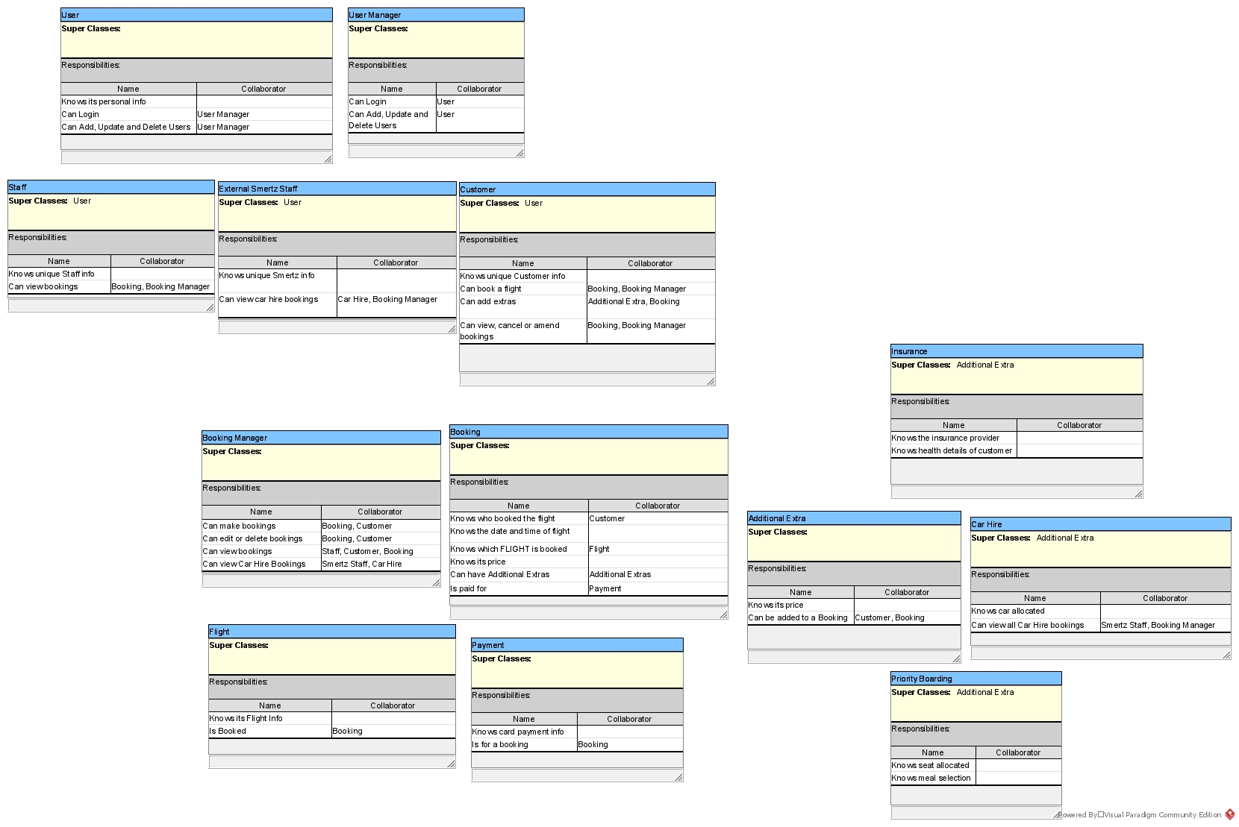

Slide 4
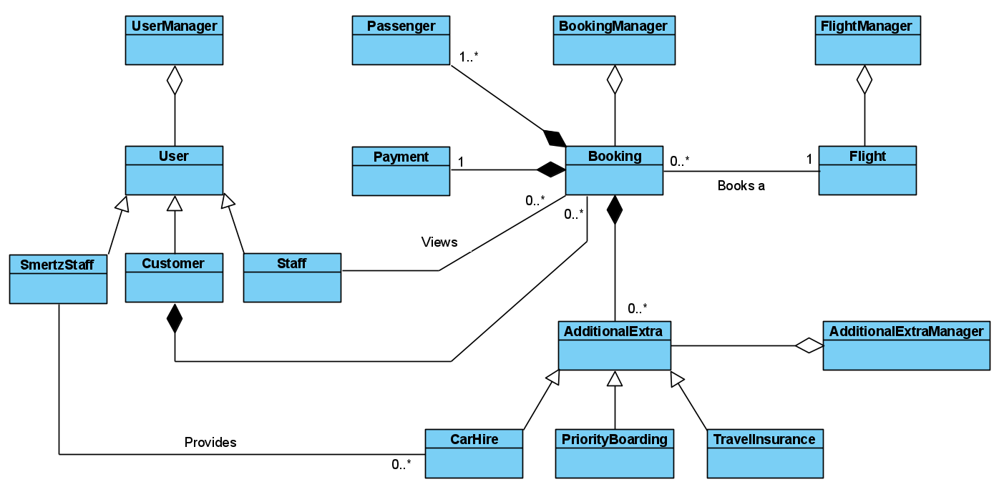


Slide 5
User Classes

Slide 6
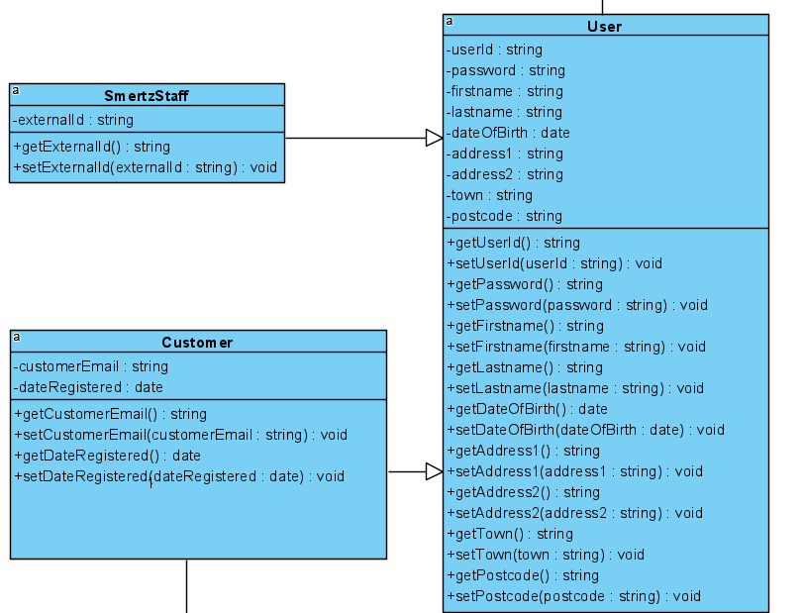
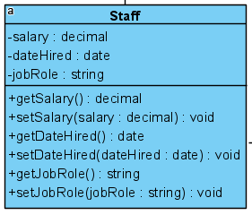


Slide 7
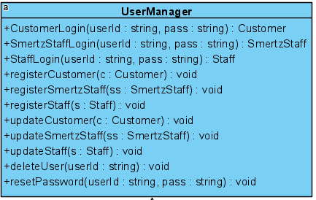
Login
CRUD
Other Functionality
(Use Case Diagram)

Slide 8
Booking / Flight / Payment / Passenger Classes

Slide 9
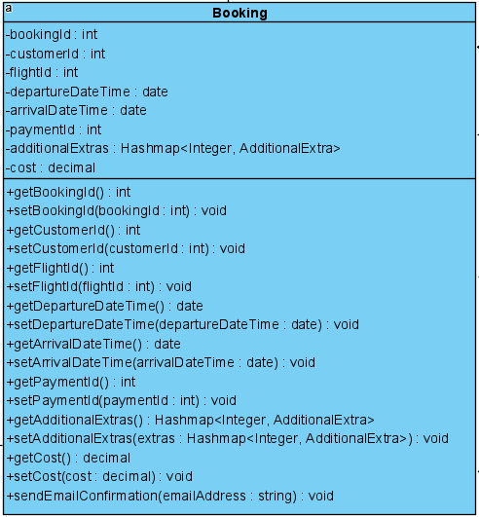
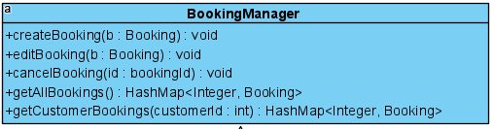
Who
What
When
Payment Info
Extras Requested
CRUD
Standard Getters +Setters
Confirm Booking via Email

Slide 10
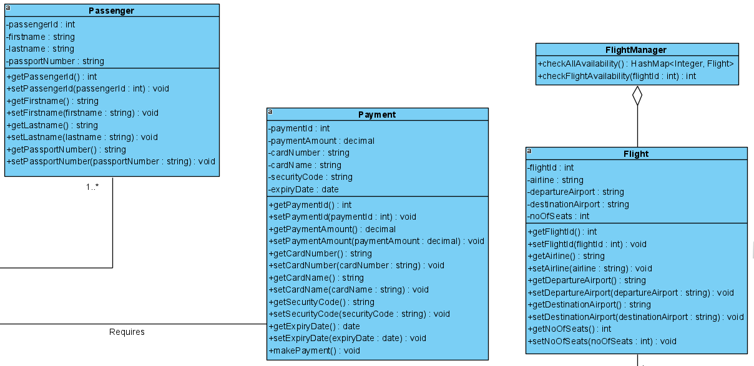
Confirms the availability of a flight
Used when the customer is searching

Slide 11
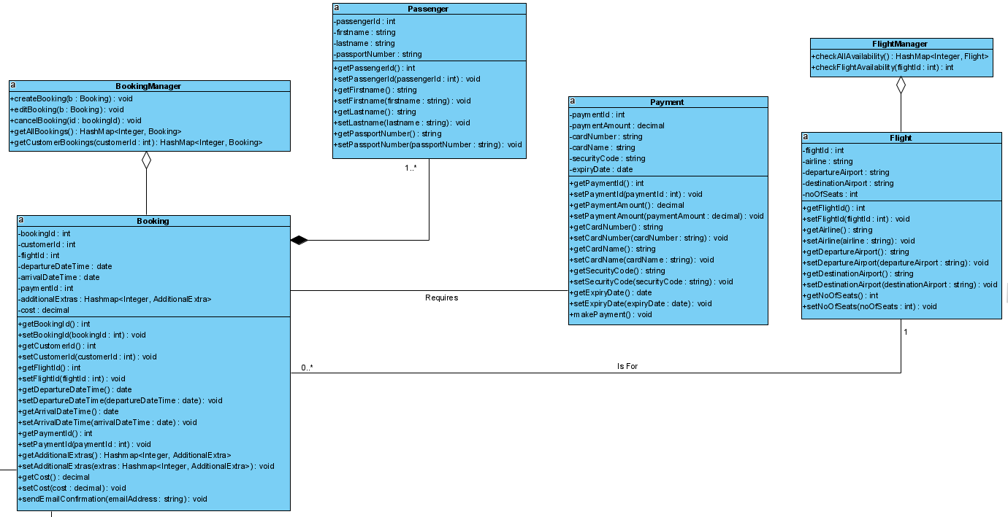

Slide 12
Additional Extra Classes

Slide 13
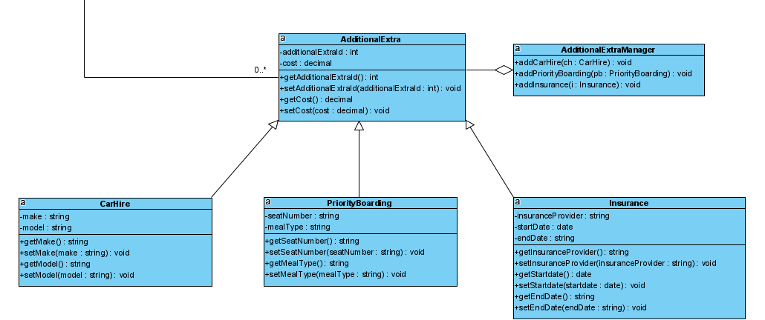

Slide 14
Complete Detailed Class Diagram

Slide 16
